Slide 1
Neuro-Symbolic Mental Health Predictor
Capstone Project-II
By : JANNU SMARAN

Slide 2
Problem Statement
Objective: To develop a Deep Learning model that accurately classifies text into four major emotional categories to identify potential mental health risks.
Scope: Focuses on multi-class classification using NLP and LSTM networks.

Slide 3
Objective
The main aim of this project is to build a system that can read text like messages or posts and understand a person’s mental condition.
It groups emotions into four types: Happy, Sad, Stress, and Anxiety, so it’s easier to understand how someone feels.
The model uses LSTM, which helps it understand the meaning of words based on their order in a sentence.
It looks for patterns in the way people write to find signs of mental stress or emotions.
Overall, the system helps in early awareness of mental health by analyzing text and giving useful predictions.

Slide 4
Dataset
The project uses the Go Emotions dataset, which contains a large number of text samples taken from online conversations.
Each text is labeled with emotions, and there are 28 different emotion categories such as joy, anger, sadness, fear, and more.
Since working with 28 emotions is complex, these are grouped into 4 main categories: Happy, Sad, Stress, and Anxiety for easier analysis.
The dataset is text-based, meaning the input is sentences or short messages.
It is also a multi-label dataset, which means a single text can have more than one emotion assigned to it.

Slide 5
Methodology
The multi-label data is first converted into a single label for each text.
The 28 emotions are grouped into four categories: Happy, Sad, Stress, and Anxiety.
The text is cleaned and normalized to make it consistent.
The text is then tokenized into words using a tokenizer.
The words are converted into numerical sequences for the model.
Padding is applied to make all input sequences the same length.
The model is trained and evaluated using metrics like Accuracy, Precision, Recall, F1 Score, and Confusion Matrix

Slide 6
Models
SimpleRNN
LSTM(Long Short Term Memory)
Model Architecture :
Embedding layer
SimpleRNN/LSTM / BiLSTM
Dense layers
Softmax output

Slide 7
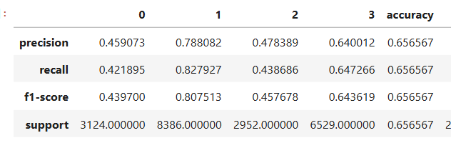
Evaluation Metrics
Accuracy
Precision
Recall
F1 Score

Slide 8
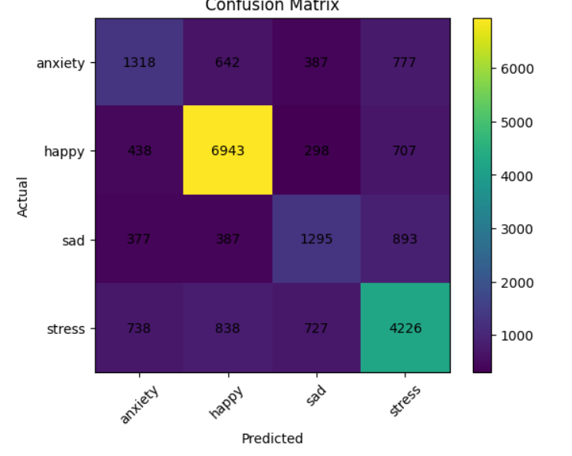
Confusion Matrix

Slide 9
Results & Conclusion
The model is able to predict emotions from text effectively.
Using a balanced dataset improves the overall performance of the model.
There is some confusion between similar emotions like stress and anxiety.
The LSTM model works well for understanding text and detecting emotions.
Proper data preprocessing plays a very important role in getting good results.
The system can be useful for mental health awareness and early understanding of emotions.

Slide 10
Future Scope
Use BERT / Transformers: Improve accuracy by using advanced models that understand text better than LSTM.
Multi-label Prediction: Allow the model to detect multiple emotions from a single text instead of just one.
Real-time Applications: Integrate the system into apps or social media to analyze emotions instantly.
Multimodal Data (Voice, Face): Combine text with voice and facial expressions for better mental health analysis.

